Slide 1
The Smartphone Project
Building a Smartphone From Scratch

Slide 2
Short and Concise SMART Goals
Build a fully functional smartphone by the middle of August
Prove that learning to build a smartphone from scratch doesn’t have to be a mystery
S
M
A
R
T

Slide 3
Specific
Attainable
S
Capable of Doing It
Hatchery Advisors
CPP Staff
Mentors
Textbooks
Comfortable to Hold
Intuitive to Use
Strong Performance
Efficient for All-Day Use
Snappy and Responsive
Customizable, Repairable, and Upgradable
M
A
Relevant
R
Demystify Technical Knowledge for Smartphones
Build Phone from Scratch
Prove Students Can Do It
Measureable
User-Defined in a Poll
Performance Testing
Real World Testing
T
Time-Bound
Define FPGA architecture
Integrate custom FPGA board
Complete hardware/PCB design
Demonstrate FPGA reconfigurability
Develop software environment
Optimize system performance [May-June]
Test real-world use cases [May-June]
Document process and challenges
Disseminate results (publications, open-source)[]
Notes:
User Defined in a Poll: “Comfortability to Hold”, “Intuitive to Use”, and “Speedy Enough to Feel Snappy and Responsive”
“Powerful enough to maintain strong performance” - Clock Speed, Voltage Regulation Test, Bandwidth, Power-Efficiency (Performance Per Watt),
“Efficient enough to endure a whole day of extensive use” - “Screen On Time”, “Real World Testing”, “Battery Capacity (mAh)”, “Battery Discharge Rate (mA)”, “Energy Efficiency Ratio (EER)”, “Component Power Draw”

Slide 4
Integrated Master Schedule
Notes:
Programmable Hardware enables
Ability for the AVERAGE PERSON to easily repair of various elements in a PRODUCT WE OWN
Ability to easily assemble/disassemble ALLOWS you to upgrade your perfectly good phone by replacing only the components on the phone that YOU want improved on your phone
Ability to make a modular phone, which would allow
YOU to make your phone distinctly YOURS (not an identical slab to everyone else)
YOU to decide what are important features to you and

Slide 5
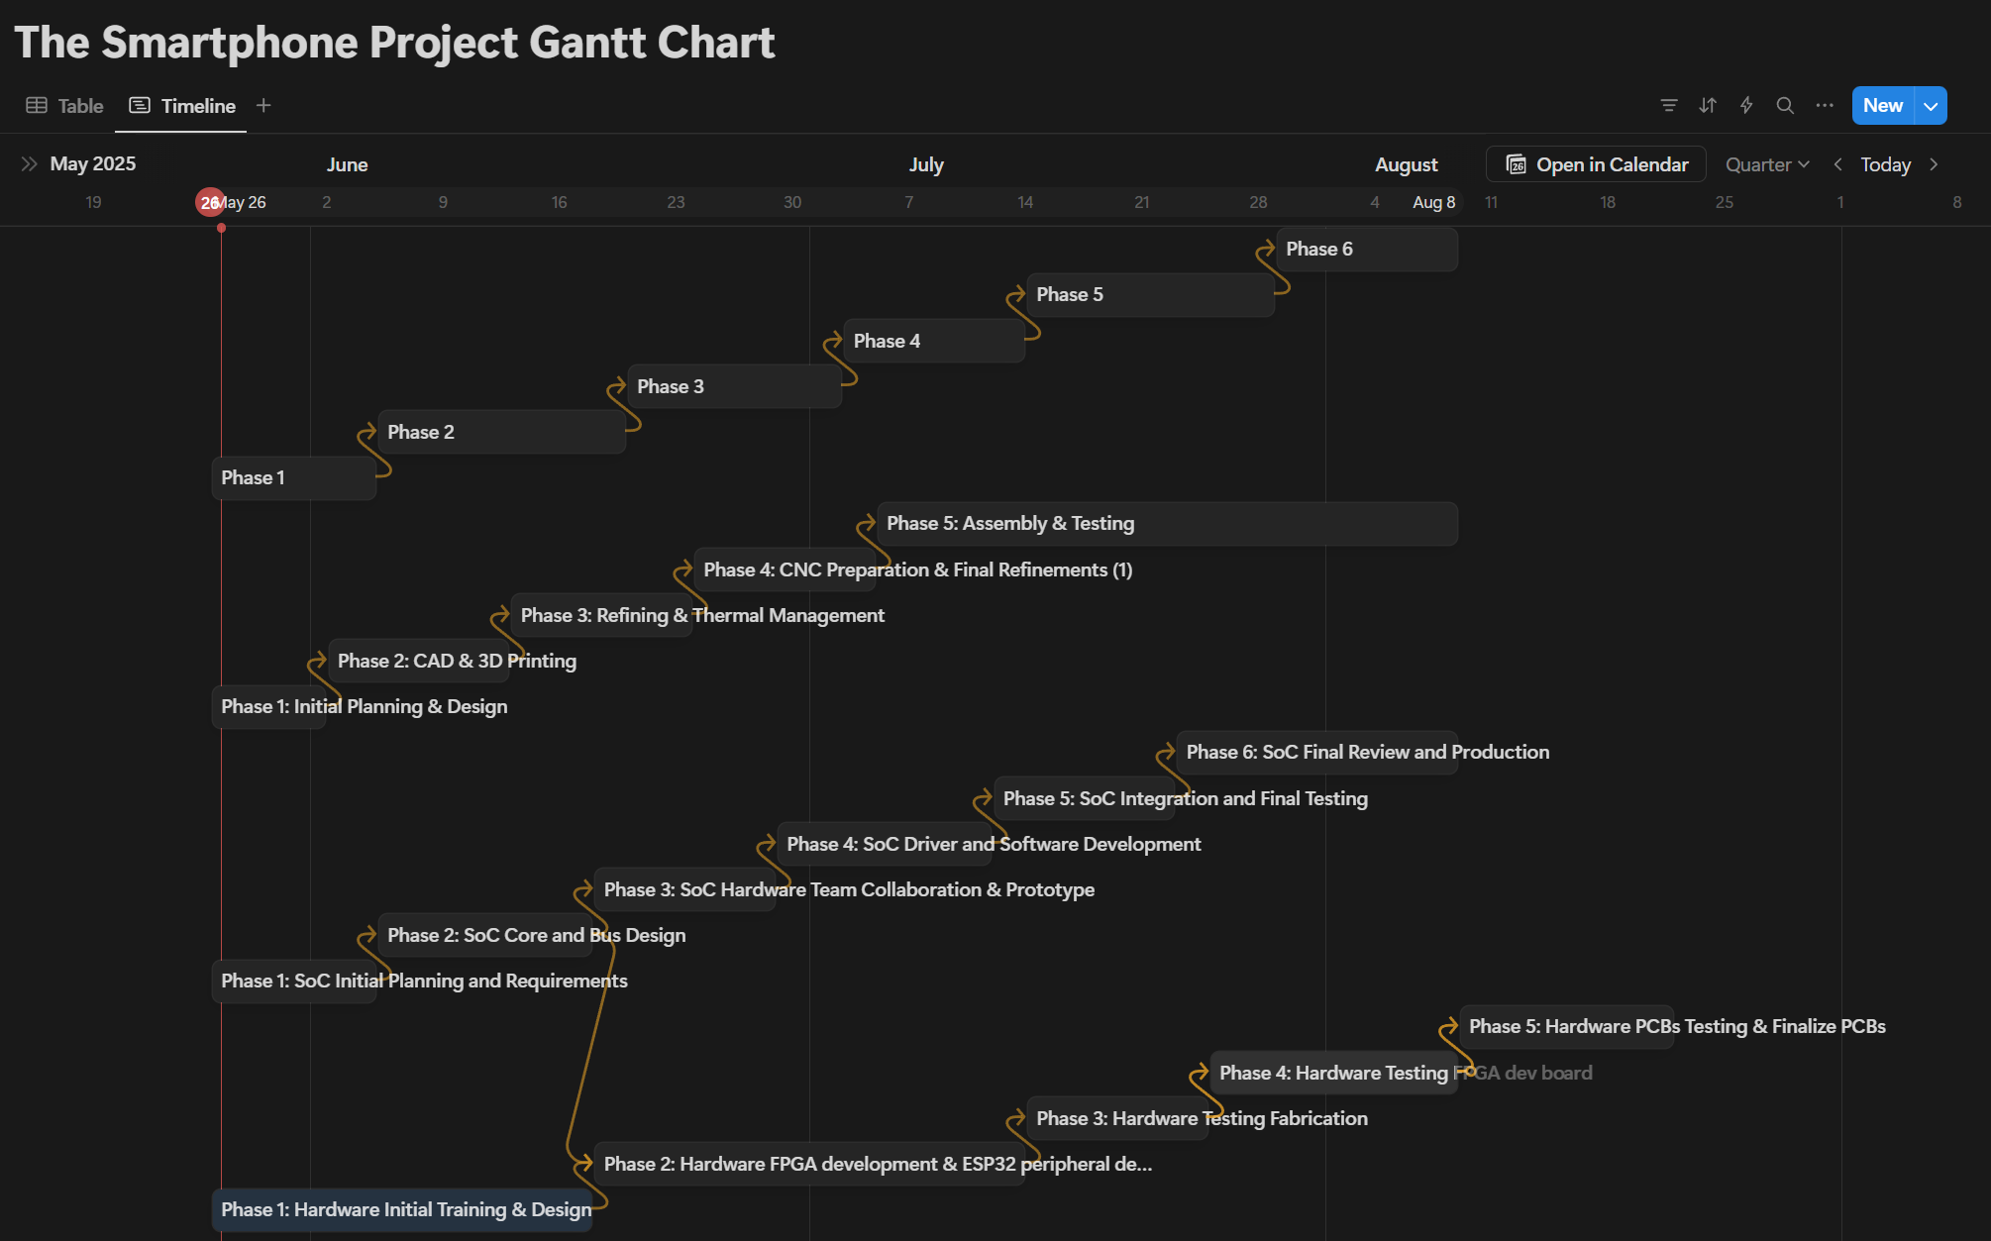
Notes:
Programmable Hardware enables
Ability for the AVERAGE PERSON to easily repair of various elements in a PRODUCT WE OWN
Ability to easily assemble/disassemble ALLOWS you to upgrade your perfectly good phone by replacing only the components on the phone that YOU want improved on your phone
Ability to make a modular phone, which would allow
YOU to make your phone distinctly YOURS (not an identical slab to everyone else)
YOU to decide what are important features to you and

Slide 6
Budget
Milestone 1
Type |  |  | Description |  |  | Qty |  |  |  |  |  |  | Budgeted
Supplies & Equipment |  |  | Liquid Crystal Display (LCD) Display Module |  |  | 2 | $30.00 |  |  | $36.00 |  |  | $51.00
Supplies & Equipment |  |  | Near Field Communication (NFC) Controller |  |  | 2 | $60.00 |  |  | $72.00 |  |  | $102.00
Supplies & Equipment |  |  | System on Chips (SoC) |  |  | 2 | $240.00 |  |  | $288.00 |  |  | $288.00
Supplies & Equipment |  |  | Memory Chip |  |  | 2 | $28.00 |  |  | $33.60 |  |  | $47.60
Supplies & Equipment |  |  | Radio Frequency (RF) Chip |  |  | 2 | $7.00 |  |  | $8.40 |  |  | $11.90
Supplies & Equipment |  |  | FPGA Development Board |  |  | 4 | $520.00 |  |  | $572.00 |  |  | $572.00
Supplies & Equipment |  |  | Battery |  |  | 2 | $30.00 |  |  | $36.00 |  |  | $51.00
Supplies & Equipment |  |  | Connectors (Audio Jacks, USB-C, Micro SD, HDMI) |  |  | 4 | $20.00 |  |  | $28.00 |  |  | $38.00
Supplies & Equipment |  |  | Microphone |  |  | 2 | $10.00 |  |  | $12.00 |  |  | $22.00
Supplies & Equipment |  |  | PCB Manufacturer |  |  | 1 | $700.00 |  |  | $800.00 |  |  | $800.00
Supplies & Equipment |  |  | Copper Heat Pipes and Spreader |  |  | 1 | $60.00 |  |  | $67.00 |  |  | $67.00
Supplies & Equipment |  |  | Thermal Pads and Paste |  |  | 1 | $40.00 |  |  | $44.00 |  |  | $50.00
Supplies & Equipment |  |  | Camera Module |  |  | 4 | $30.00 |  |  | $42.00 |  |  | $42.00
Supplies & Equipment |  |  | Miscellaneous Components (Capacitors, Resistors, etc.) |  |  | 1 | $200.00 |  |  | $240.00 |  |  | $210.00
Supplies & Equipment |  |  | ESP-32 Modules |  |  | 10 | $55.00 |  |  | $65.00 |  |  | $80.00
 |  |  |  |  |  | Total |  |  |  |  |  |  | $2,432.50

Slide 7
Budget
Milestone 2
Type |  |  | Description |  |  | Qty |  |  |  |  |  |  | Budgeted
Stipends |  |  | PCB Manufacturer |  |  | 1 | $700.00 |  |  | $800.00 |  |  | $800.00
Supplies & Equipment |  |  | Heat Gun |  |  | 1 | $150.00 |  |  | $165.00 |  |  | $165.00
Suplies & Equipment |  |  | USB/Cable Tester |  |  | 1 | $79.99 |  |  | $90.00 |  |  | $120.00
Suplies & Equipment |  |  | Multimeter and Clamp Meter Kit |  |  | 1 | $384.93 |  |  | $400.00 |  |  | $420.00
Suplies & Equipment |  |  | Hot Plate |  |  | 1 | $60.00 |  |  | $70.00 |  |  | $90.00
Suplies & Equipment |  |  | Addiotonal Equipment/Components (Budget Room) |  |  | 1 |  |  |  |  |  |  | $750.00
Supplies & Equipment |  |  | Aluminum Phone Frame (Raw Aluminum, Finishing) |  |  | 1 | $475.00 |  |  | $522.50 |  |  | $600.00
 |  |  |  |  |  | Total |  |  |  |  |  |  | $2,945.00

Slide 8
Budget
Milestone 3
Type |  |  | Description |  |  | Qty | Material Cost |  |  | Tax + Shipping |  |  | Budgeted
Stipends |  |  | Project Manager Stipend |  |  |  |  |  |  |  |  |  | $1,872.50
Stipends |  |  | Team Members Stipend (Tentative) [Extra Room in Budget]
 |  |  |  |  |  | Total |  |  |  | $3,345.50 |  |  | $1,872.50
TOTALS
How many student team members do you have? |  |  |  |  |  | 10 |  |  |  |  |  |  | Milestone 1
Allotted Budget |  |  |  |  |  | $8,000.00 |  |  |  |  |  |  | Total |  | $2,432.50
 |  |  |  |  |  |  |  |  |  |  |  |  | Milestone 2
 |  |  |  |  |  |  |  |  |  |  |  |  | Total |  | $2,945.00
 |  |  |  |  |  |  |  |  |  |  |  |  | Milestone 3
 |  |  |  |  |  |  |  |  |  |  |  |  | Total |  | $1,872.50
 |  |  |  |  |  |  |  |  |  |  |  |  | Entire Project

Slide 9
Team Breakdown Structure
Project Manager
Sunny Nguyen
Business
Hardware
System
Software
Business Coordinator
Russell Chung
SoC Engineer
Andy Zhang
Hardware Egr
Max Gross
System Egr Leads
Hoanh Lam
Back-end Developer
Danny Tran
RF Comm
Angelo Duenas
Enclosure Engineer
Viren Kumar
System Egr
Nathan Alquicira
Front-end Developer
Izaiah Ortiz

Slide 10
Meet The Teams: The Hardware Teams
Hardware
System on A Chip
Hardware Design
Designs CPU, GPU, and peripherals.
Uses SystemVerilog for implementation.
Tests and verifies live circuits.
Designs PCBs.
Designs Power Management Systems.
Designs Schematics
RF Communications
Enclosure & Thermals
Defines RF subsystem architecture.
Works on antennas and transceivers.
Develops RF filters and drivers.
Integrates RF with custom SoC.
Manages smartphone heat dissipation.
Designs casing for cooling efficiency.
Uses CAD and thermal analysis.
Notes:
Programmable Hardware enables
Ability for the AVERAGE PERSON to easily repair of various elements in a PRODUCT WE OWN
Ability to easily assemble/disassemble ALLOWS you to upgrade your perfectly good phone by replacing only the components on the phone that YOU want improved on your phone
Ability to make a modular phone, which would allow
YOU to make your phone distinctly YOURS (not an identical slab to everyone else)
YOU to decide what are important features to you and

Slide 11
Meet The Teams: The Software, Systems, and Business Teams
Software
Systems Engineering
Operating System
Aligns hardware and software teams.
Ensures seamless system integration.
Defines architecture, requirements, and constraints.
Develops a custom operating system.
Builds and maintains smartphone apps.
Optimizes performance, efficiency, security.
User Interface and Experience
Business
Designs intuitive smartphone interface.
Ensures smooth and responsive experience.
Manages Finances
Works with Systems Engineering To Determine Whether Design Choices Fit in Budget

Slide 12
Project Milestones
Define the complete FPGA-based smartphone architecture and its component specifications (FPGA, memory, peripherals).
Develop and integrate the custom FPGA board with core components (processing core, memory, I/O).
Complete hardware integration and PCB design. Demonstrate FPGA reconfigurability with basic applications.
Develop and integrate the software environment for user programming and hardware reconfiguration.
01
02
03
04
Notes:
Programmable Hardware enables
Ability for the AVERAGE PERSON to easily repair of various elements in a PRODUCT WE OWN
Ability to easily assemble/disassemble ALLOWS you to upgrade your perfectly good phone by replacing only the components on the phone that YOU want improved on your phone
Ability to make a modular phone, which would allow
YOU to make your phone distinctly YOURS (not an identical slab to everyone else)
YOU to decide what are important features to you and

Slide 13
Project Milestones
Optimize system performance (energy, speed, user interaction). Test real-world use cases
Document the entire process, challenges, solutions, and final performance evaluations.
Disseminate results through publications, open-source releases, and outreach activities.
05
06
07
Notes:
Programmable Hardware enables
Ability for the AVERAGE PERSON to easily repair of various elements in a PRODUCT WE OWN
Ability to easily assemble/disassemble ALLOWS you to upgrade your perfectly good phone by replacing only the components on the phone that YOU want improved on your phone
Ability to make a modular phone, which would allow
YOU to make your phone distinctly YOURS (not an identical slab to everyone else)
YOU to decide what are important features to you and

Slide 14
Thank you

